Slide 1
Prime-Probe Attack
Side-Channel Attack

Slide 2
CONTENTS
Side-channel attack
Prime-probe attack
Attack on local machine
Cross-VM attack
Source of Noise

Slide 3
PART1
Side-channel attack

Slide 4
Side-channel attack
The security mechanisms have to be implemented according to cryptographic algorithms and to meet the security goals of the security systems.
Although the security mechanisms can control and specify what functions can be performed, they cannot specify how their functions are implemented.
Moreover, cryptographic algorithms are always implemented in the hardware or the software of physical devices that interact with, and are influenced by their environments.
These interactions can be monitored and instigated by attackers.

Slide 5
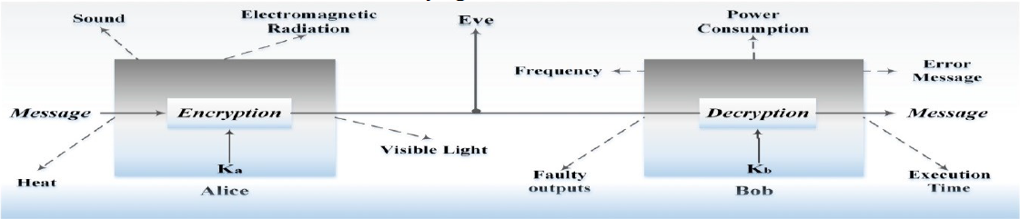
Side-channel attack
The gap between how security functions are specified and how they are implemented, has led to a new class of attack, which is a side-channel attack.
Side-channel attacks are an implementation level attack on cryptographic systems. It exploits a correlation between highlevel functionalities of the software and the underlying hardware phenomena.

Slide 6
Side-channel attack
These attacks are generally categorized into one of three classes:
A time-driven side-channel attack
A trace-driven side-channel attack
A access-driven side-channel attack
The attacker program monitors usage of a shared architectural component to learn information about the key, e.g., the data cache , instruction cache , or branch-prediction cache.

Slide 7
PART2
Prime-probe attack

Slide 8
CPU Cache
Cache is a small high speed section of memory built in and outside the CPU as illustrated in figure.
It is usually a Static RAM (SRAM) that any requested data must go through. It contains the most recently accessed data and frequently accessed memory addresses.
Furthermore, cache can lead to massive speed increases by keeping frequently accessed data and reducing time taken to evict and fetch data from the main memory.
It is utilised to increase the speed of memory access as the time to execute an instruction is by far lower than the time to bring an instruction (or piece of data) into the processor.

Slide 9
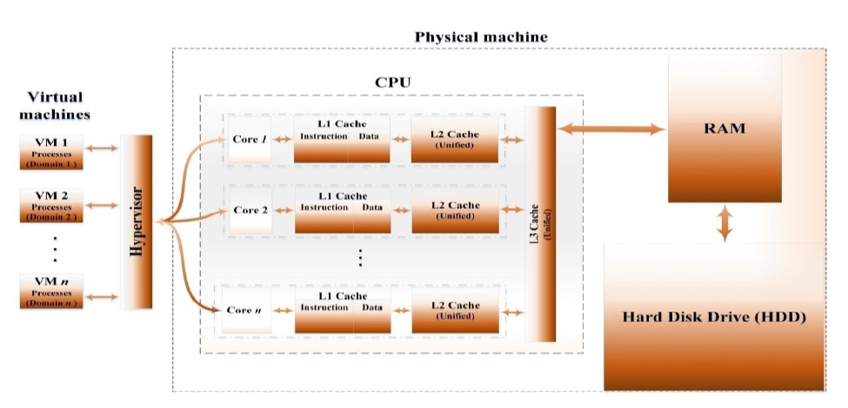
CPU Cache

Slide 10
CPU Cache
Why CPU Cache?
CPU caches are always an interesting target to adversaries due to the following reasons:
They are shared among VMs or cores. Therefore, an attacker can easily use clients’ co-residence or VM physical co-residency to interfere and exfiltrate sensitive information of victims.
They have a higher-rate of computing interactions between processes.
They have the most fine-grained and detailed information about the state of computing operations running on a system.

Slide 11
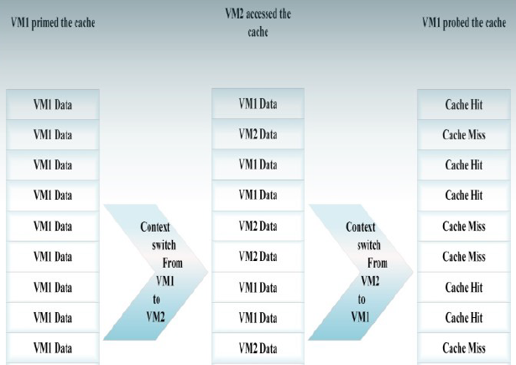
Prime-probe attack
The prime-probe protocol. A common method for conducting an access-driven cache attack is to Prime and later Probe the cache, a so-called prime-probe protocol.

Slide 12
Prime-probe attack
More specifically, a VCPU U of the attacker’s VM spies on a victim’s VCPU V by measuring the cache load in the L1 instruction cache in the following manner:
Prime: U fills one or more cache sets by the method described above.
Idle: U waits for a prespecified prime-probe interval while the cache is utilized by V .
Probe: U times the duration to refill the same cache sets to learn V ’s cache activity on those sets.

Slide 13
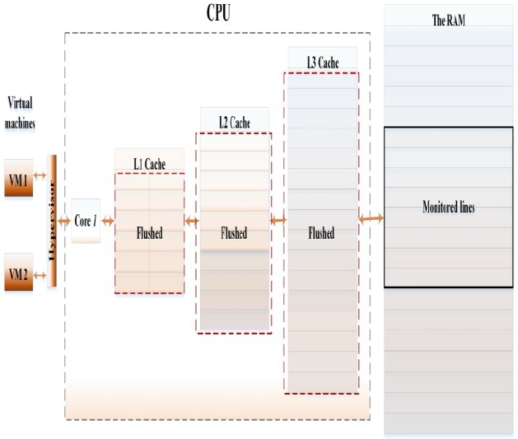
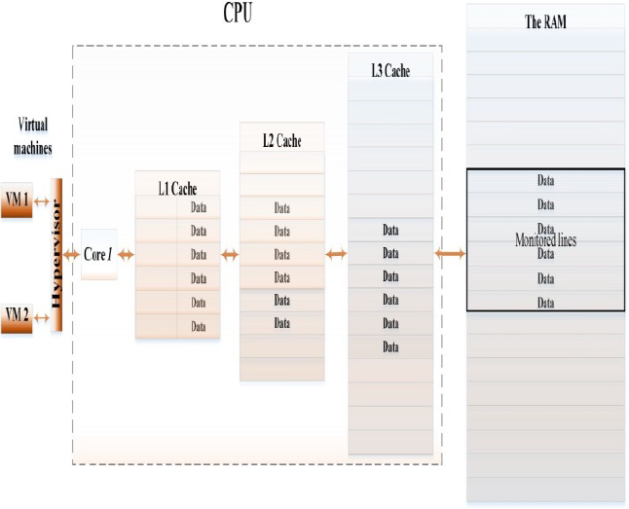
Flush-reload attack

Slide 14
PART3
Attack on Local machine

Slide 15
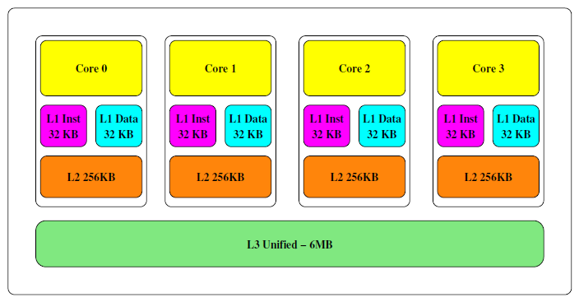
Attack on Local machine

Slide 16
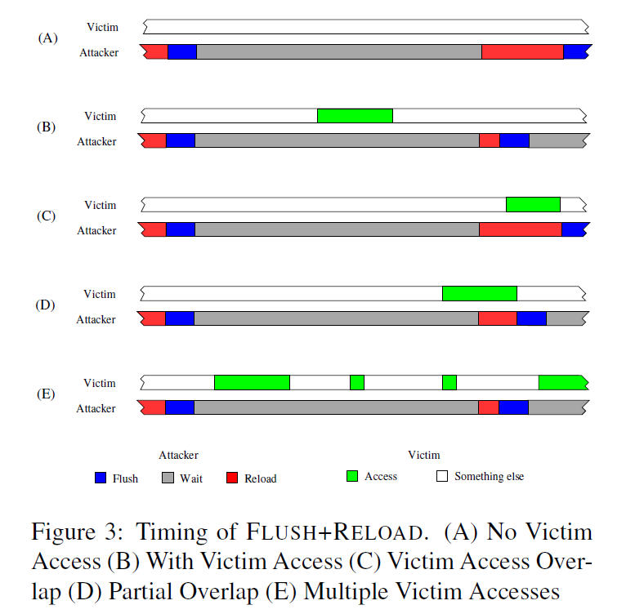
Attack on Local machine

Slide 17
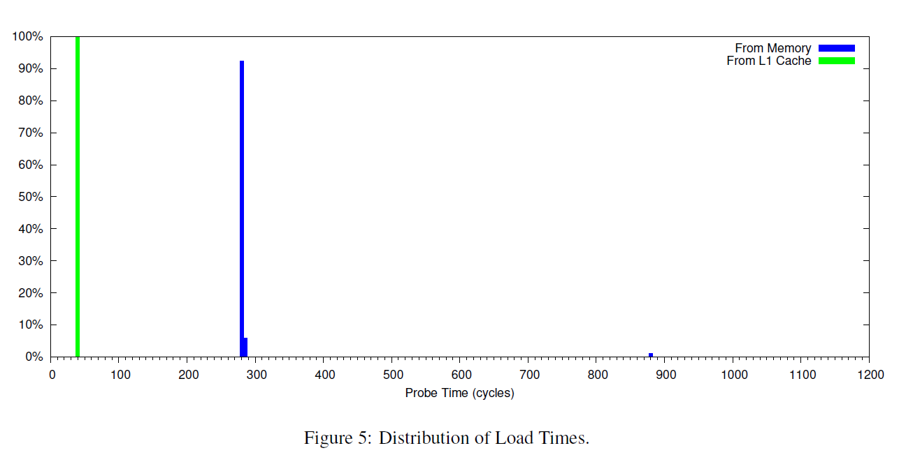
Attack on Local machine

Slide 18
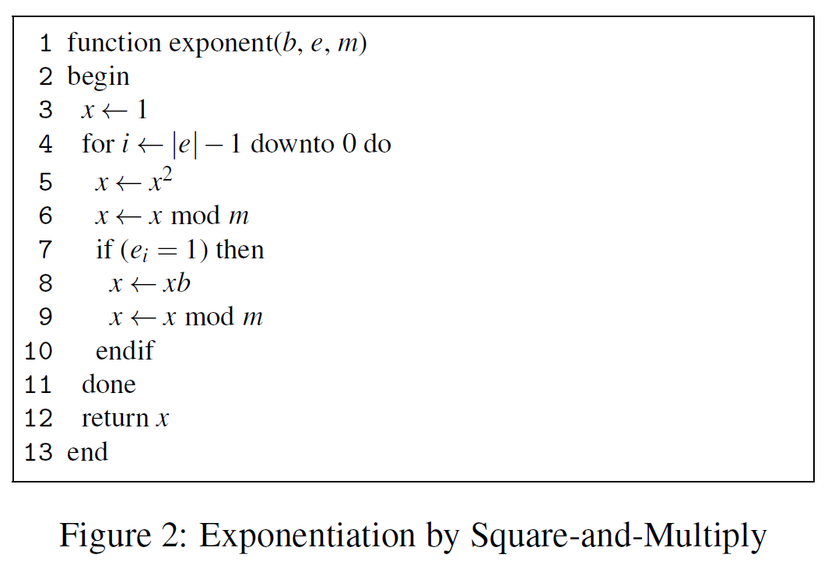
Attack on Local machine

Slide 19
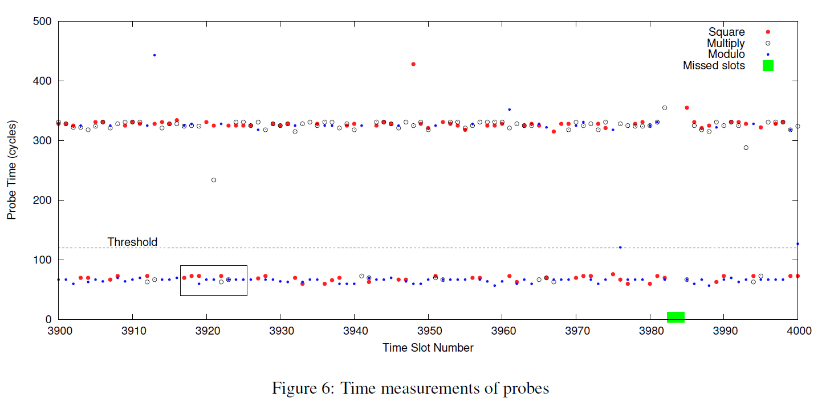
Attack on Local machine

Slide 20
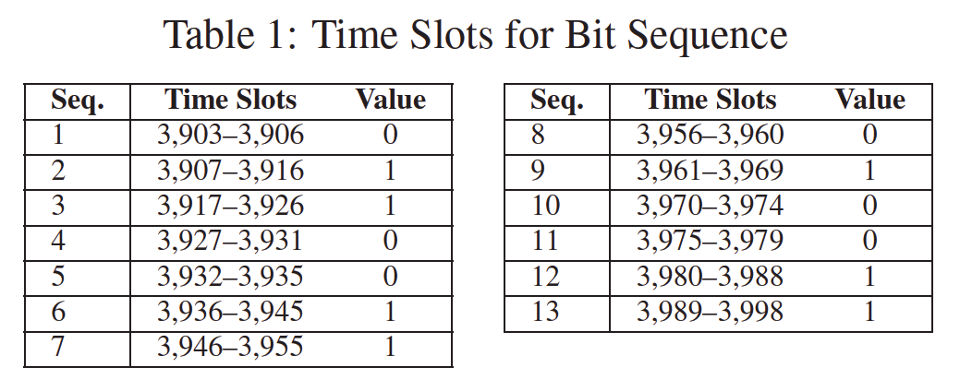
Attack on Local machine

Slide 21
PART4
Attack cross-VM

Slide 22
Attack cross-VM
The paper details the construction of an access-driven side-channel attack by which a malicious virtual machine extracts fine-grained information from a victim VM running on the same physical computer. This attack is the first such attack demonstrated on a symmetric multiprocessing system virtualized using a modern VMM (Xen). Such systems are very common today, ranging from desktops that use virtualization to sandbox application or OS compromises, to clouds that co-locate the workloads of mutually distrustful customers. Constructing such a side-channel requires overcoming challenges including core migration, numerous sources of channel noise, and the difficulty of preempting the victim with sufficient frequency to extract fine-grained information from it.

Slide 23
Attack cross-VM
Challenge 1: Observation granularity. The way Xen scheduling works in our SMP setting makes spying on a victim VM challenging, particularly when one wants to use per core microarchitectural features as a side channel.
For example, the L1 caches contain the most potential for damaging side-channels, but these are not shared across different cores. An attacker must therefore try to arrange to frequently alternate execution on the same core with the victim so that it can measure side-effects of the victim’s execution.

Slide 24
Attack cross-VM
Challenge 2: Observation noise. Even with our IPI-based spying mechanism, there exists significant noise in the measured timings of the L1 instruction cache. Beyond the noise involved in any cache-based measurements, the VMM exacerbates noise since it also uses the L1 cache when performing scheduling. Manual analysis failed to provide simple threshold-based rules to classify cache timings as being indicative of particular victim operations.

Slide 25
Attack cross-VM
Challenge 3: Core migration. Our SMP setting has attacker and victim VCPUs float amongst the various PCPUs. The administrative Dom0 VM and any other VMs may also float amongst them. This gives rise to two hurdles. First, we must determine whether an observation is associated with the victim or some other, unrelated VCPU. Second, we will only be able to spy on the victim when assigned to the same PCPU, which may coincide with only some fraction of the victim’s execution.

Slide 26
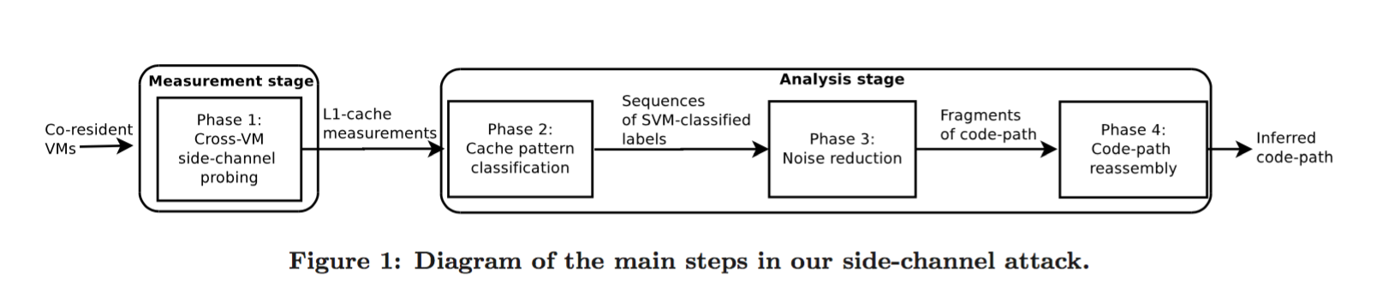
Attack cross-VM

Slide 27
PART5
Source of Noise

Slide 28
Source of Noise
TLB Miss
In x86 processors, hardware TLBs are usually small set-associative caches that cache the translation from virtual addresses to physical addresses.
A TLB miss will cause several memory fetches. Because the TLB is flushed at each context switch, the Probe of the first cache set will always involve TLB misses and so will be abnormally high; as such, the Probe results for the first cache set will be discarded.
However, in our approach, the number of memory pages used for the prime-probe protocol is small enough to avoid further TLB evictions.

Slide 29
Source of Noise
Speculative execution
Modern superscalar processors usually fetch instructions in batches and execute them out-of-order. In order to force the in-order execution of our Probe code for accurate measurement, the instructions need to be serialized using instructions like “mfence”.

Slide 30
Source of Noise
Power Saving
The speed of a Probe may be subject to change due to PCPU power saving modes. If the attacker VM is solely occupying a PCPU core, when it finishes its Probe and relinquishes PCPU resources, the core may be slowed to save power.
When the interrupt is delivered to the attacker VCPU, it appears to take longer for the PCPU to recover from the power saving mode.
Thus, longer-then-expected prime-probe intervals may indicate there was no victim on the same core and so their results are discarded.

Slide 31
Source of Noise
Context Switch
A Xen hypervisor context switch will pollute the cache. Moreover, noise due to a guest OS context switch in the attacker VM may introduce additional difficulties.
Although there is not much we can do about the hypervisor context-switch noise, we minimize the OS context switch noise by modifying the core affinity of all the processes in the attacker VM so that all user-space processes are assigned to the IPI VCPU, minimizing context switches on the probing VCPU.
This is beneficial also because it enables the probing VCPU to relinquish the PCPU as much as possible, allowing another VCPU (hopefully, the victim’s) to share its PCPU.

Slide 32
Source of Noise
Emulated RDTSC instruction
In the absence of an invariant timestamp counters, Xen 4.0 or later emulates the rdtsc call to prevent time from going backwards.
In this case, the rdtsc call is about 15 or 20 times slower than the native call, which diminishes the attacker VM’s ability to measure the duration to Probe a cache set.
As such, the attack we describe here works much more reliably when the rdtsc call is not emulated.

Slide 33
Source of Noise
Interference from other domains.
One important aspect of software noise in the cache-based side channel is interference from other domains besides the victim.
The fact that the attacker VCPU may observe activities of Dom0 or other domains brings about one of a major difficulties in this study: how can an attacker VM distinguish victim activity of interest from cache activity from unrelated?

Slide 34
Noise reduction
Cache pattern classifier
Hidden Markov model(HMM)

